Slide 1
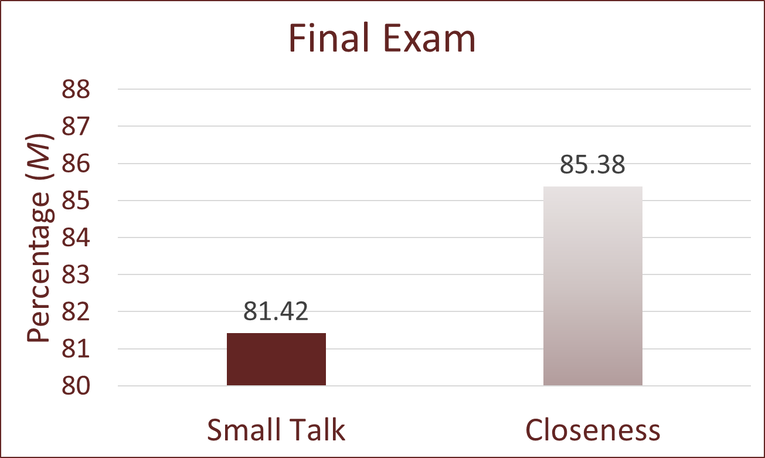
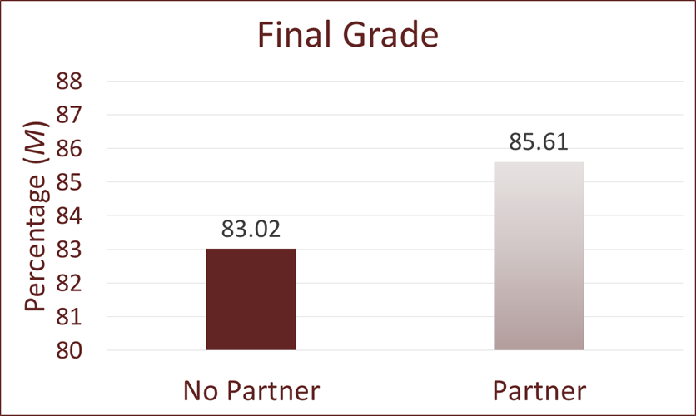
Improving Academic Outcomes by Fostering Social Connections
Kyndal S. DeBerry, Kenneth J. Denton, PhD, and Danney Rasco, PhD
West Texas A&M University
Theoretical Background
Results
Discussion
The main duty of University professors and other academic professionals is to maximize students’ academic performance in their classrooms. Researchers have found that when discussing student success and academic performance, “engagement matters” (Tinto, 2014). Student engagement and sense of belonging are critical to student achievement (Kahu & Nelson, 2018). Much of the research focuses on student's engagement with the university (Kanu & Nelson, 2018) or with faculty members (Frisby & Martin, 2010). Researchers of this study were curious as to whether a sense of engagement could be attained through social connections with peers and if perceived connectedness has a positive impact on academic performance.
Results suggest that participating in the closeness-induction task and interacting with a classmate positively impact course performance. For example, every 1-point increase on the partner evaluation was associated with a half-point increase on the final exam. Thus, students who perceived themselves as more connected performed better academically.
Implications and Future Directions
Professors can use this knowledge to adjust their course structure and improve students’ performance through partner activities that encourage closeness.
Researchers can examine the effects of closeness-induction tasks on university retention rates and maintaining these relationships to further improve performance.
Method
Final exam scores were higher for students who completed the closeness-induction task (M = 85.38, SD = 9.95) compared to students in the small-talk condition (M = 81.42, SD = 12.46), t (119) = -1.91, p = .03.
Participants
Participants (N = 156) were recruited from General Psychology courses. They were primarily traditional-age (M = 19.57. SD = 3.01) white (n = 76) women (n = 119) who were classified as college freshmen (n = 79) and sophomores (n = 37).
Procedure
Students were randomly assigned to pairs within sections of their General Psychology courses. Pairs were randomly assigned to complete either a closeness-induction task or a less personal small-talk task for 18 minutes. Pre-intervention and follow-up data were collected for individuals whose partner did not show up.
Measures
Students evaluated their partners on how close and similar they felt as well as how likely they were to seek an ongoing relationship with the partner; possible scores ranged from 4 to 36.
Academic performance was measured using percentage correct on the final exam and final grade in the course.
References
Aron, A., Melinat, E., Aron, E. N., Vallone, R. D., & Bator, R. J. (1997). The
experimental generation of interpersonal closeness: A procedure and some preliminary findings. Personality and Social Psychology Bulletin, 23, 363–377. https://doi.org/10.1177/0146167297234003
Bean, J. P., & Bradley, R. L. (1986). Untangling the satisfaction-performance
relationship for college students. The Journal of Higher Education, 57, 393– 412. http://doi.org/10.1080/00221546.1986.11778785
Frisby, B., Martin, M. (2010) Instructor–student and student–student rapport in
the classroom, Communication Education, 59:2, 146-164.
Kahu, E., Nelson, K. (2018) Student engagement in the educational interface:
understanding the mechanisms of student success, Higher Education
Research & Development, 37:1, 58-71.
Tinto, V. (2014). Selected publications of Vincent Tinto. Journal of Student Affairs In Africa, 2(2). 214-338.
Informed Consent
Random Assignment
Contact Information
Kyndal S. DeBerry
Research Assistant
West Texas A&M University
ksdeberry1@buffs.wtamu.edu
Kenneth Denton, PhD
Assistant Professor of Psychology
West Texas A&M University
kdenton@wtamu.edu
Closeness-Induction Task
Small-Talk Task
Students who talked with a partner scored higher in the course (M = 85.61, SD = 7.00) compared to students who did not have a partner arrive (M = 83.02, SD = 9.12), t (154) = -1.80, p = .04.
Partner Evaluation
Acknowledgements
Research was supported by the Killgore Faculty Research Grant from West Texas A&M University (WT).
Conference travel was sponsored by the WT College of Education and Social Sciences.
We appreciate the help and support of the research assistants from the WT Social Psychology Lab: Shelby Day, Levi Reid, Rodina Scott, Victoria Srygley, and Amanda Torrez.
Course Performance
Note: Unstandardized regression coefficient, ** p < .01
Partner evaluation following the small-talk or closeness-induction task was positively associated with final exam performance, F (1, 119) = 7.51, p = .007.

